Slide 1
Common Tools in Cellular and Molecular Biology

Slide 2
What are you looking for?
Levels of:
  DNA
  RNA
  Protein
How to alter:
  Molecular Pathways
  Genes
  Gene expression
How to visualize:
  Cells
  Cellular components
  Genome
  Transcriptome

Slide 3
Blots
 | Southern | Northern | Western
Molecule Detected | DNA | mRNA | Protein
Gel Electrophoresis | Agarose | Formaldehyde Agarose | Polyacrylamide
Gel Pretreatment | Depurination, denaturation, and neutralization | - | -
Blotting Method | Capillary Transfer | Capillary Transfer | Electric Transfer
Probes | DNA Radioactive or nonradioactive | cDNA, cRNA Radioactive or nonradioactive | Primary Antibody
Detection System | Autoradiography Chemiluminescent Colorimetric | Autoradiography Chemiluminescent Colorimetric | Chemiluminescent Colorimetric

Slide 4
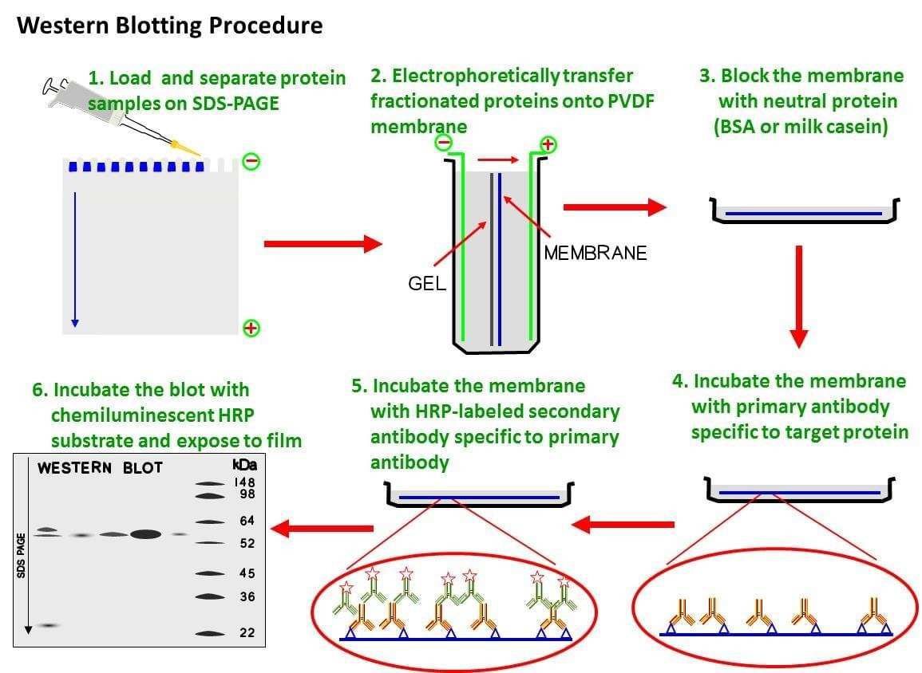

Slide 5
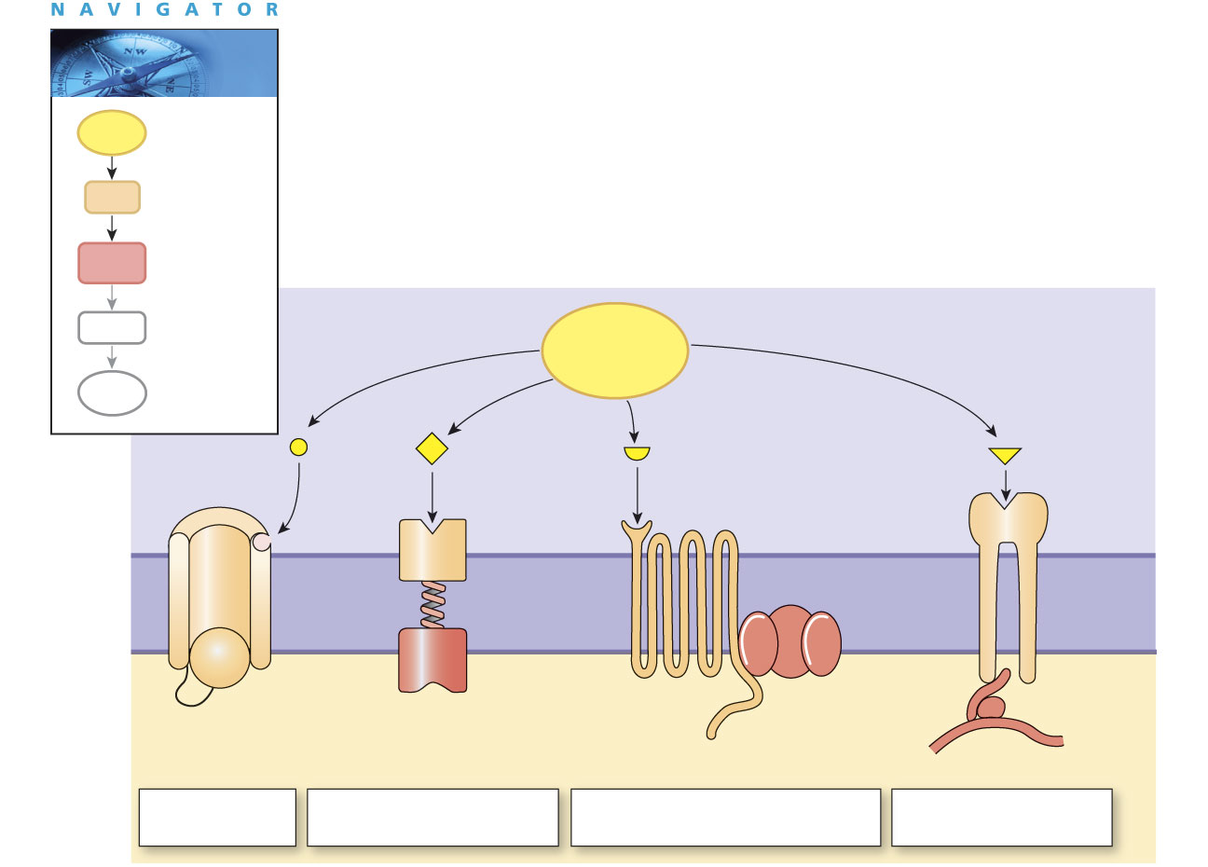
Signal Pathways: Membrane Receptors
Signal
molecule
Receptor
Intracellular
signal
molecules
Extracellular
signal
molecules
ECF
Channel
Receptor
Receptor
Integrin
Cell
membrane
Anchor
protein
Enzyme
G protein
ICF
Cytoskeleton
Receptor-
channel
Receptor-enzyme
G protein-coupled receptor
Integrin receptor

Slide 6
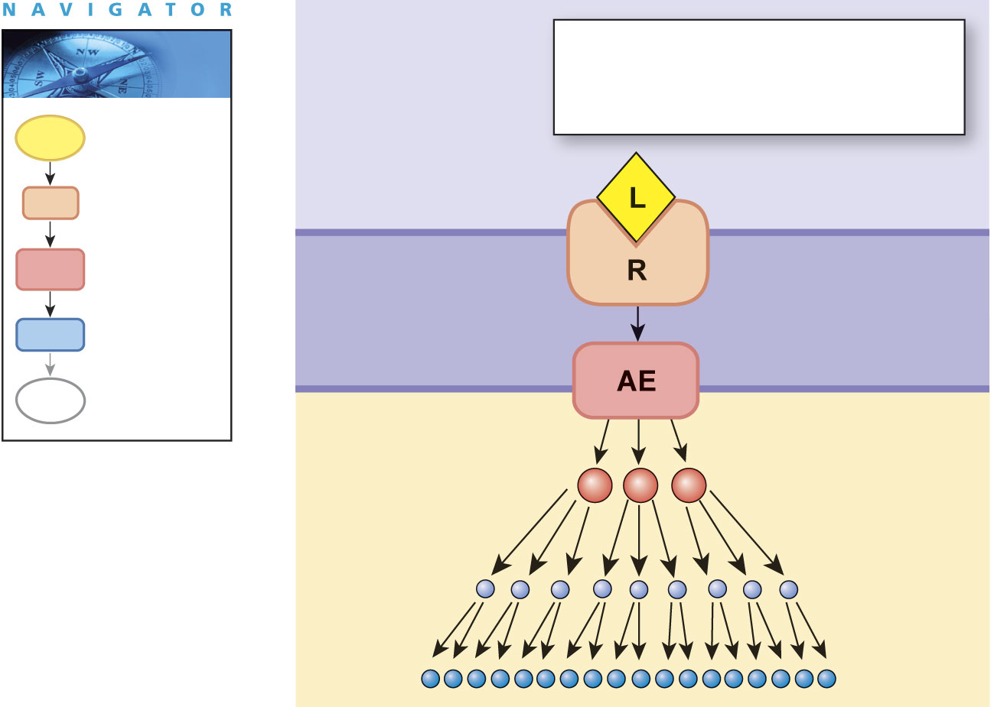
Signal Amplification
Transducers convert extracellular signals into intracellular messages which create a response
Receptor-ligand complex
activates an
amplifier enzyme (AE).
Signal
molecule
Extracellular
fluid
Receptor
Intracellular
signal
molecules
Cell
membrane
Target
proteins
Intracellular
fluid

Slide 7
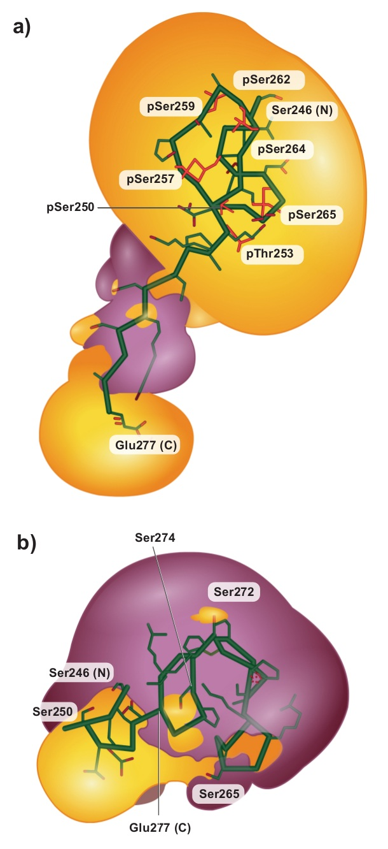
Figure 2
Phosphorylation
Phosphorylation frequently changes protein’s conformation
and surface charge.
Phosphate groups (PO₄³⁻)
affect electrostatic attraction
and repulsion within protein, changing its shape.
Notes:
7

Slide 8
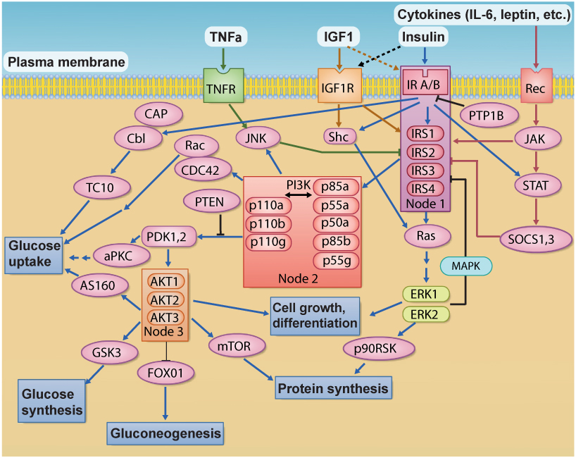
Figure 10
Signaling networks

Slide 9
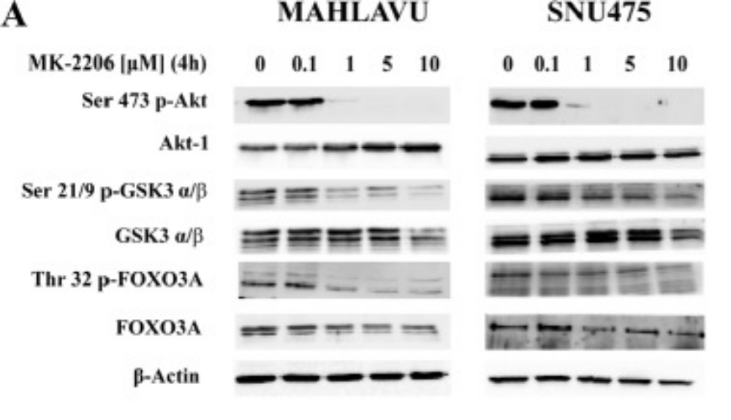

Slide 10
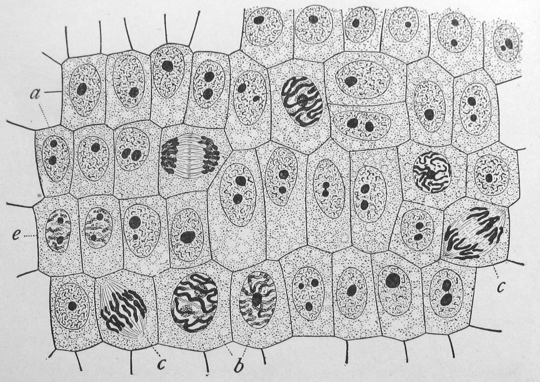
Visualizing Cells
Light Microscopy
Electron Microscopy
Fluorescence
Immunolabeling

Slide 11
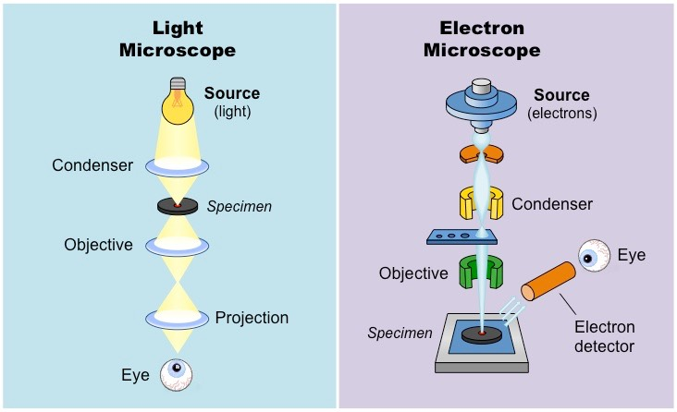
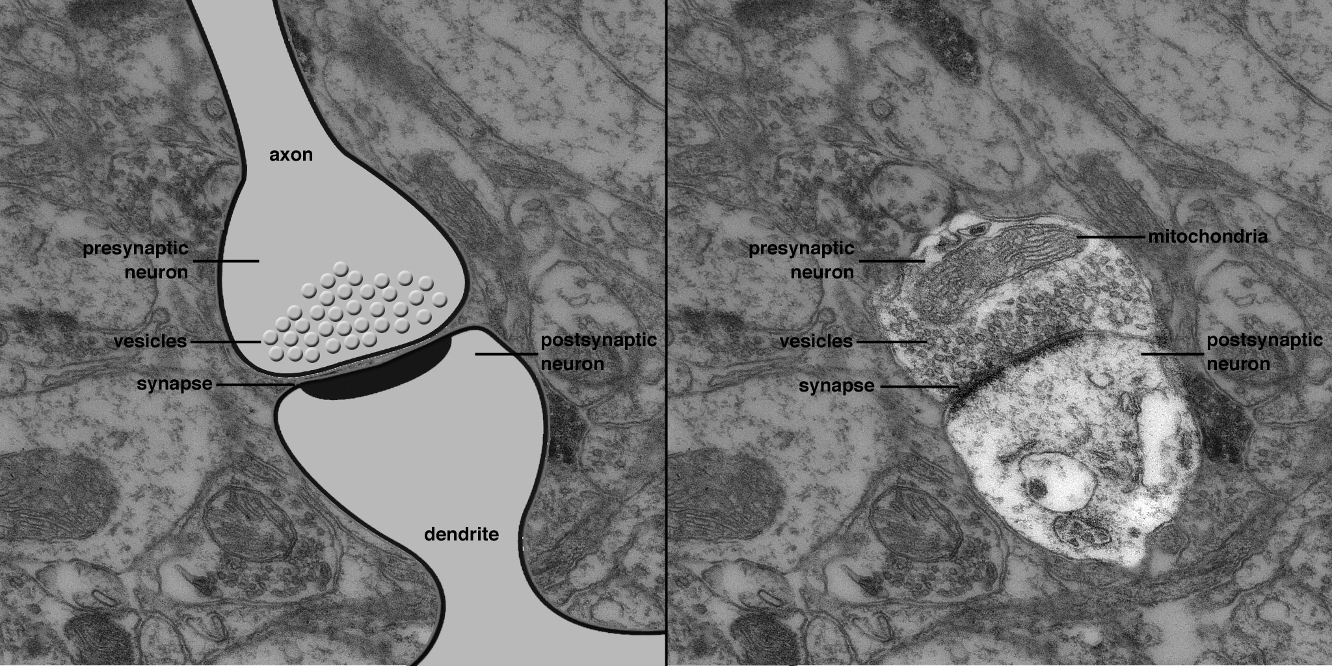
Light Microcspy vs Electron Microscopy

Slide 12
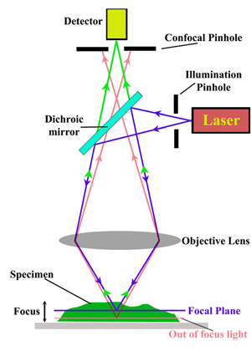
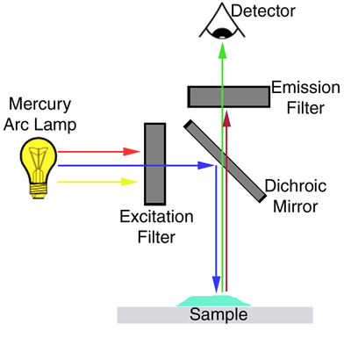
Fluorescence Microscopy

Slide 13
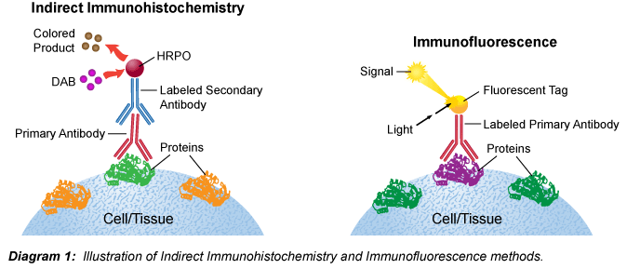
Immunostaining

Slide 14
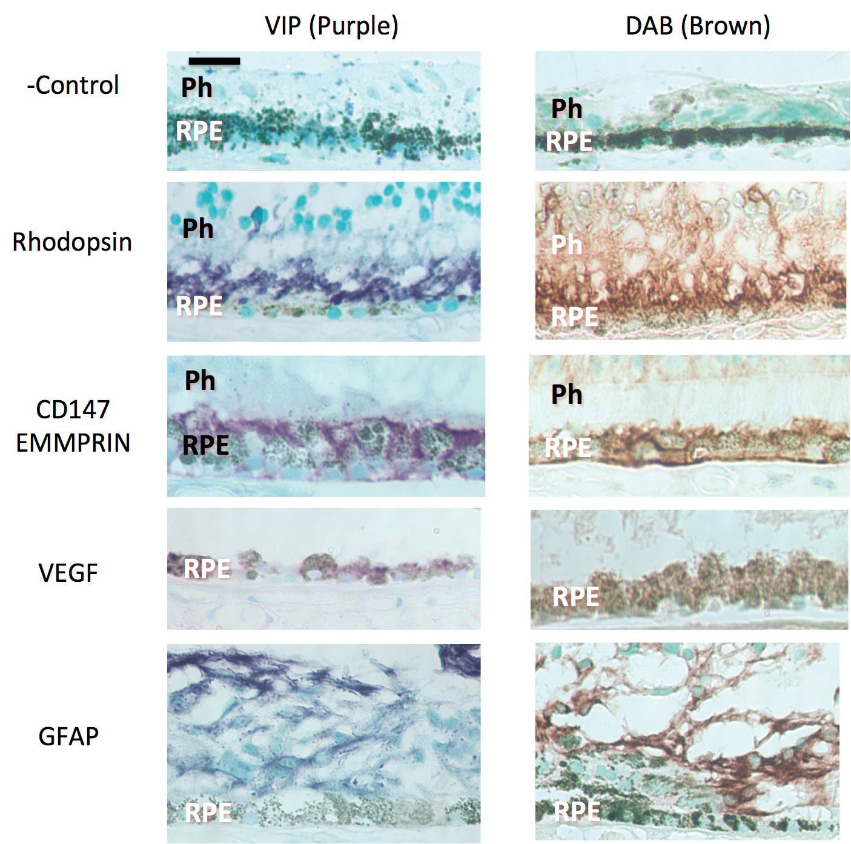
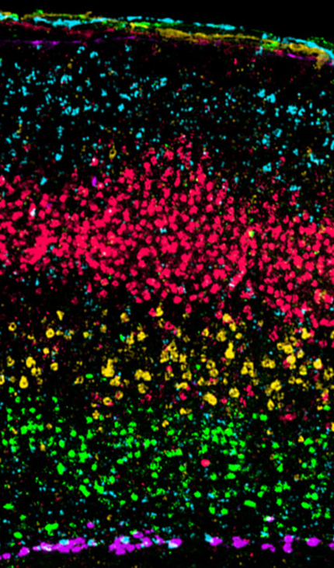
Immunostaining Light vs Fluorescence

Slide 15
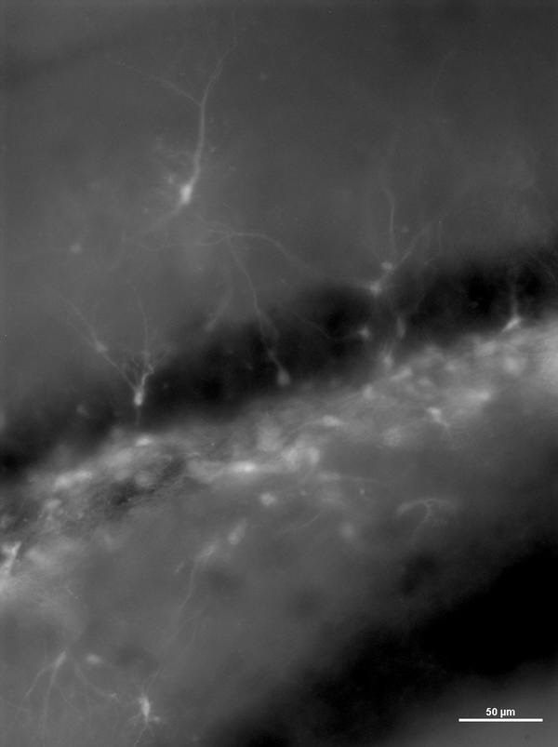
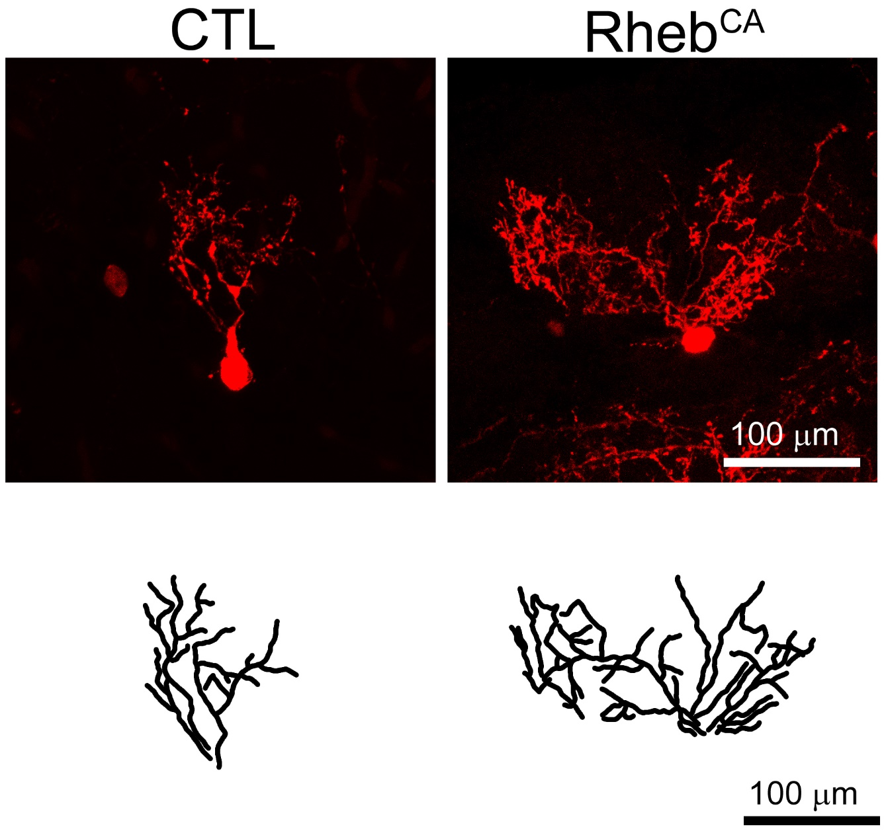
Epifluorescence vs Confocal

Slide 16
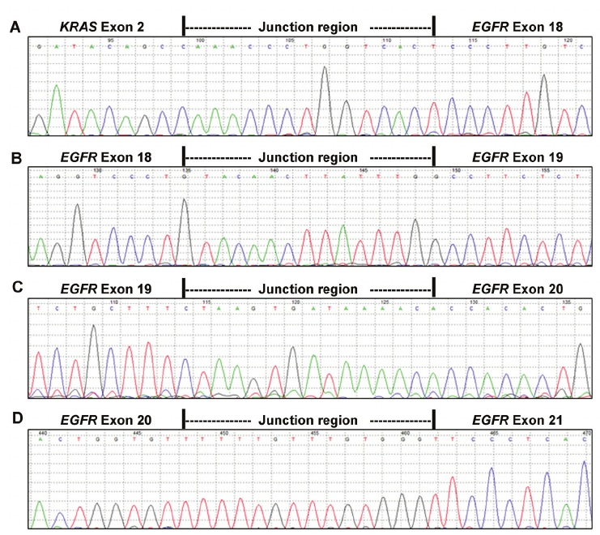
Looking at the Genome
Full length sequencing
Sequencing transcribed genes

Slide 17
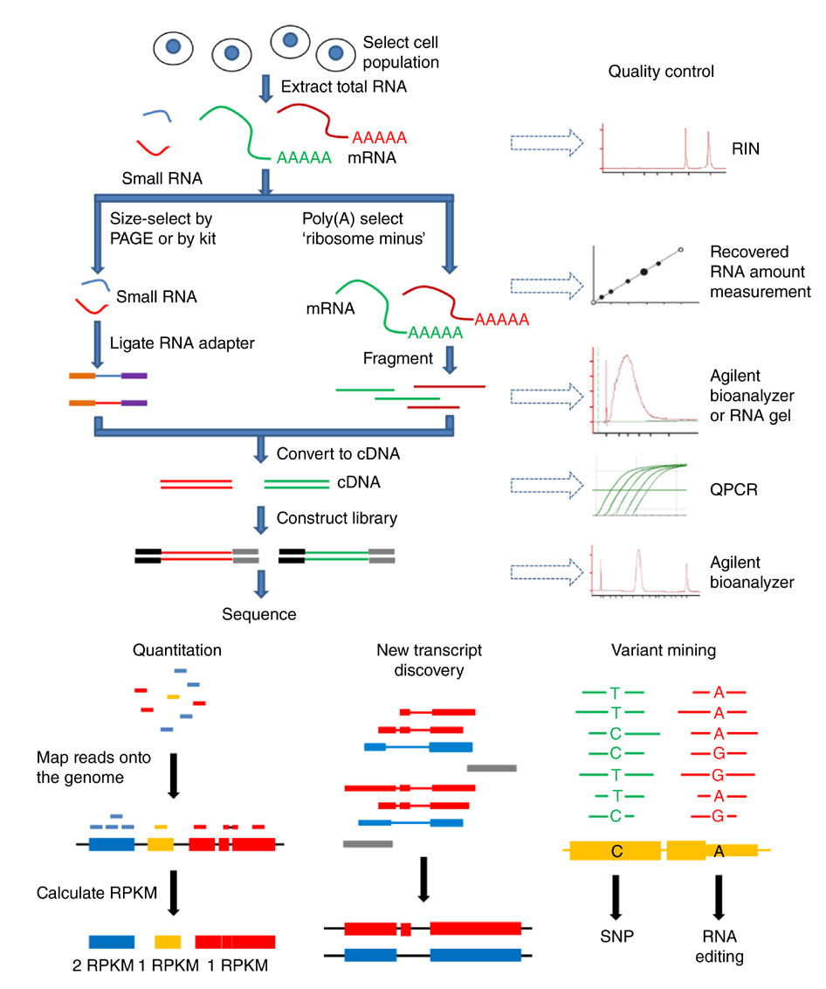
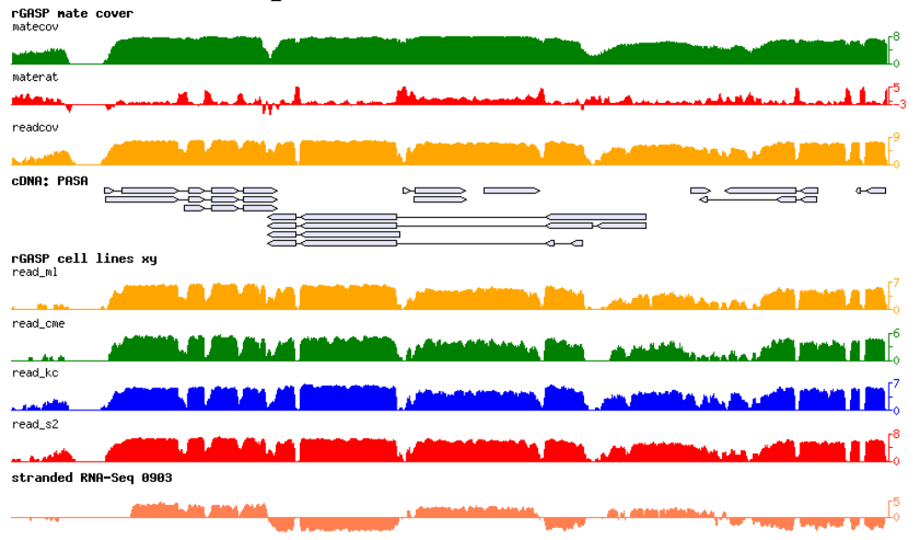
RNA-Seq

Slide 18
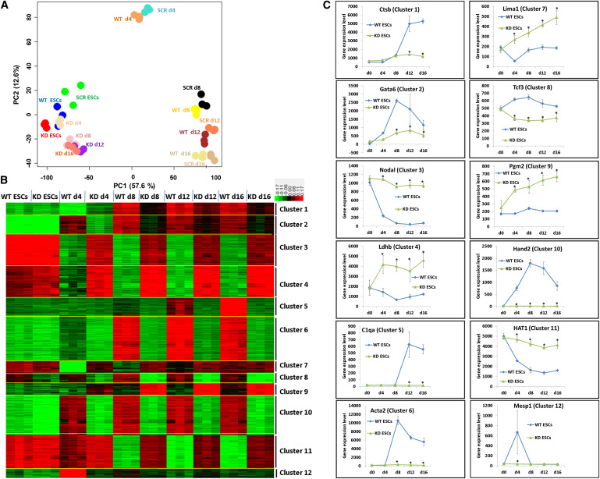
The Transcriptome

Slide 19
Common Tools to Study Developmental Biology

Slide 20
What question are you trying to answer?
When are cells born or is their proliferation affected?
  Birthdating, immunostaining for cell cycle markers, flow cytometry
What happens to the cell lineage?
  Labeling cell lines via transfection
How does this gene do something?
  Gene hacking, transgenic animals, RNAi
What is the role of the environment on these cells?
  Transplantation studies, Xenotransplantation

Slide 21
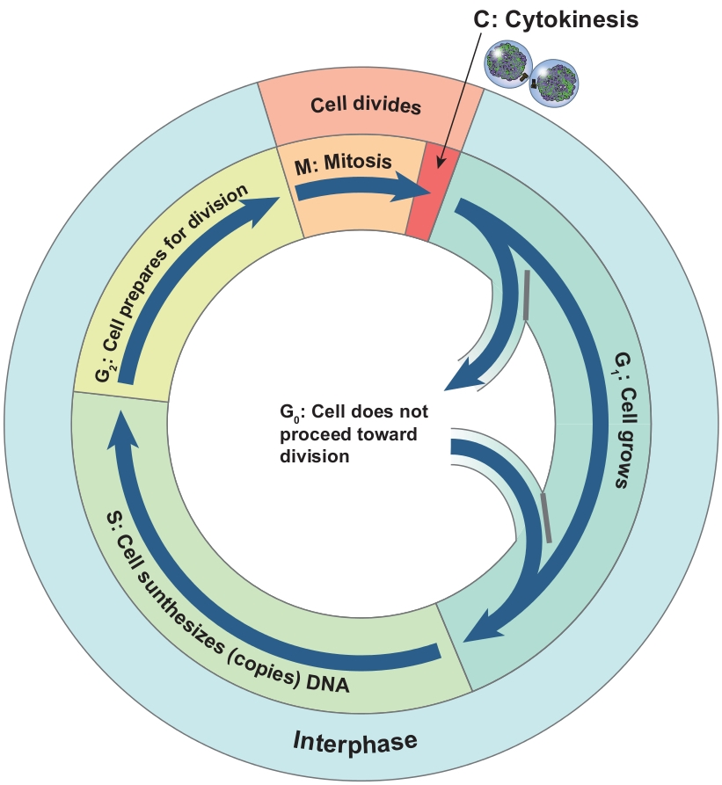
Birthdating
BrdU, EdU, CldU, IdU

Slide 22
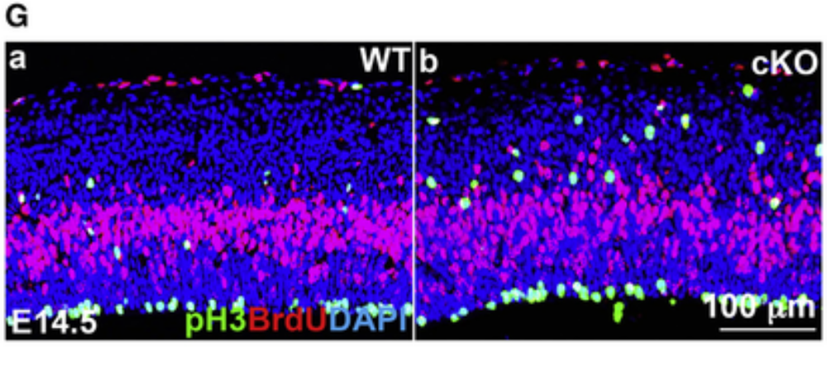

Slide 23
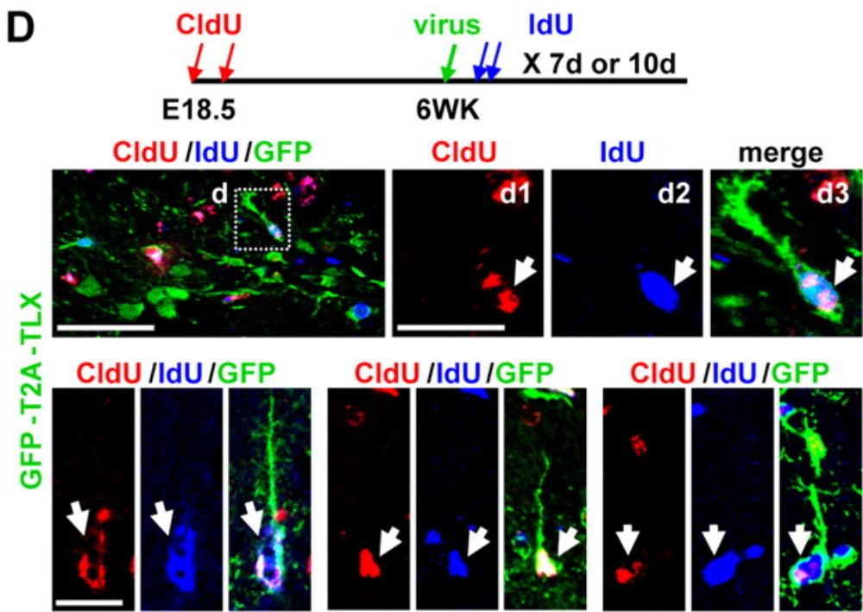
Pulse Chase to Find Cycling Cells

Slide 24
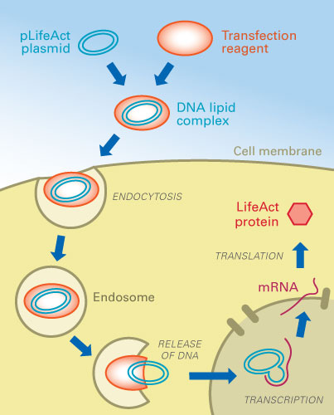
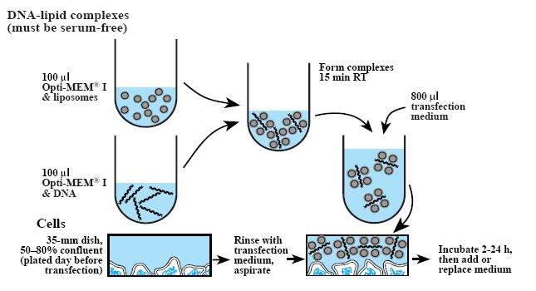
Transfections

Slide 25
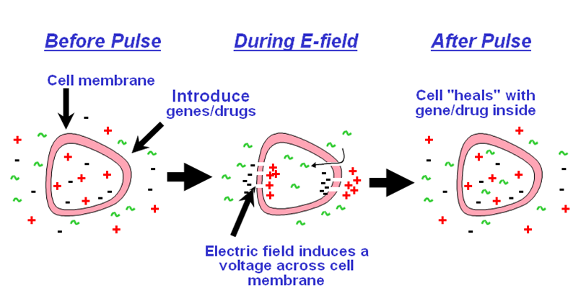
Transfecting Cells

Slide 26
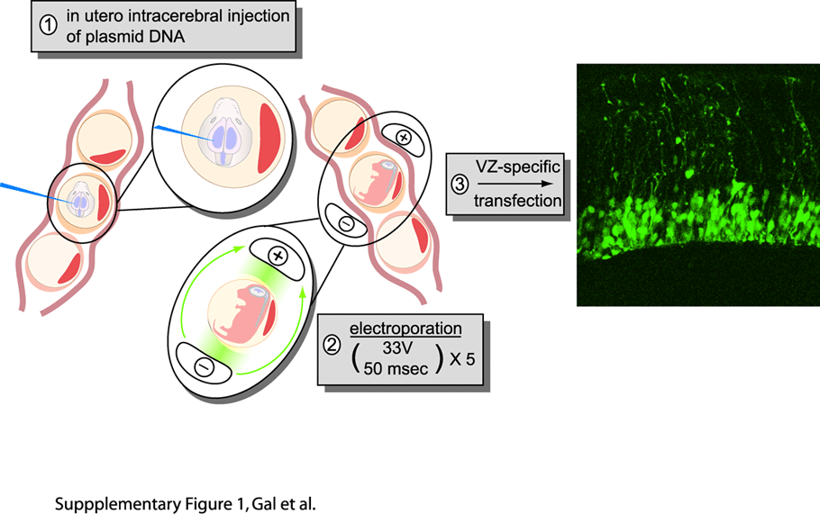
In Utero Electroporation

Slide 27
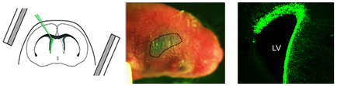
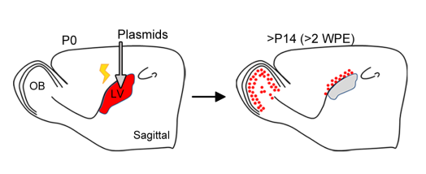
Postnatal Elctroporation

Slide 28
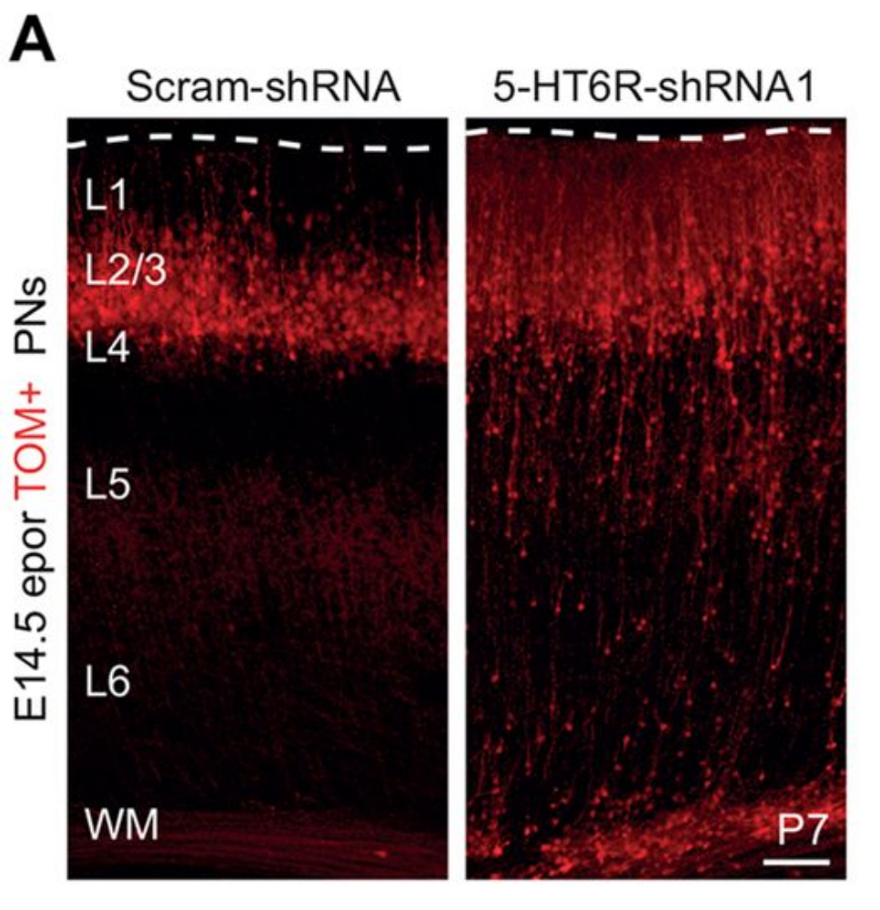
Lineage Analysis

Slide 29
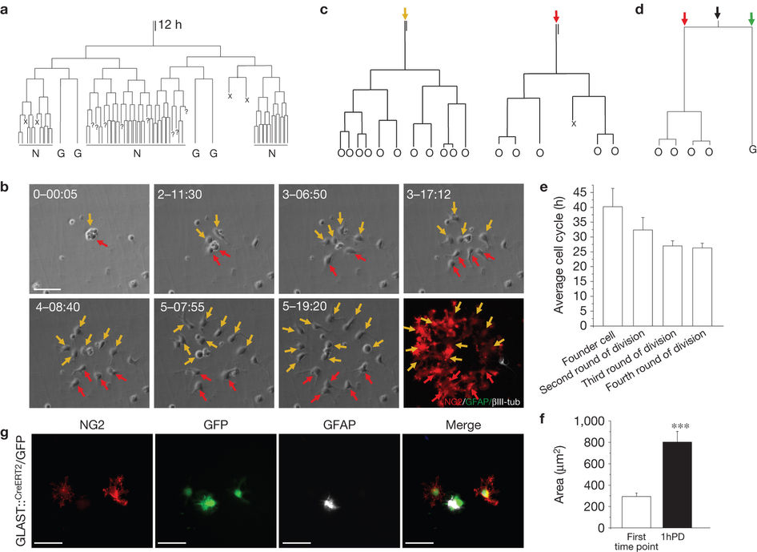
Lineage Analysis In Vitro

Slide 30
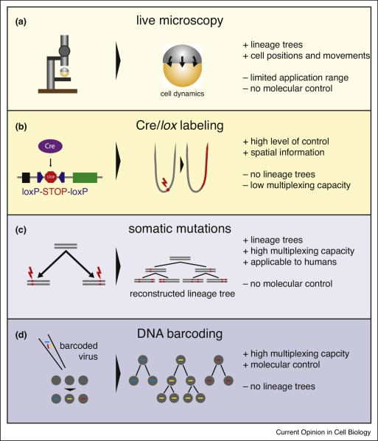
Summary of Lineage Tracing Approaches

Slide 31
Gene Editing Procedures
IR to make random mutations
Knockout
Retrovirus insertion (random mutations)
CRISPR-Cas9

Slide 32
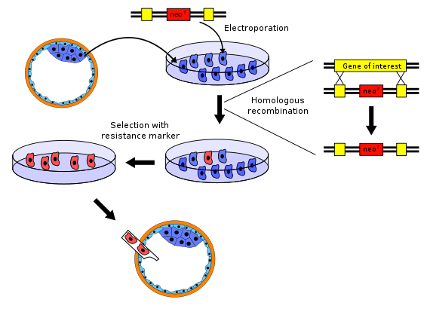
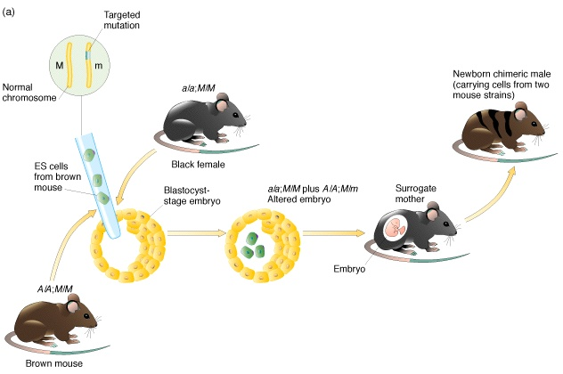
How to make a Knockout Mouse

Slide 33
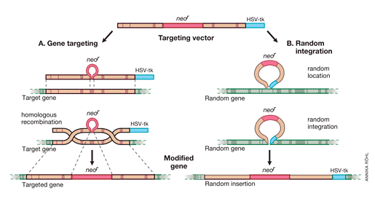
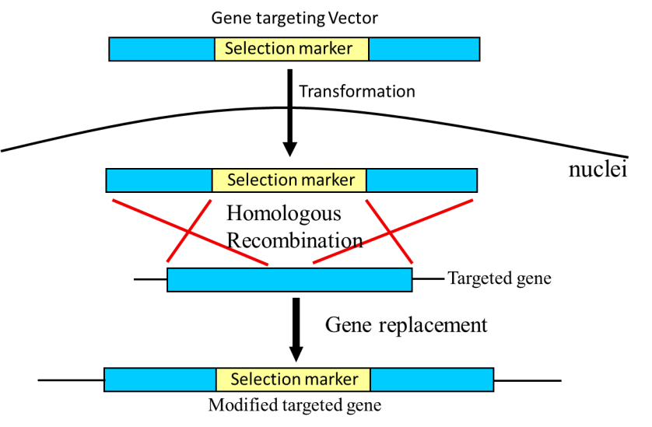
Hack the Genome!

Slide 34
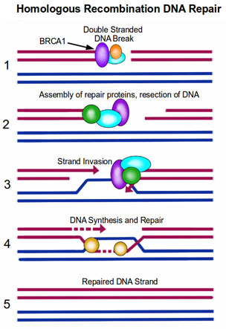
Homologous Recombination
You must know the DNA sequence of the gene you want to replace.
Next fabricate the DNA construct you want to replace the wild-type allele.
When homologous chromosomes align in metaphase, the construct finds the targeted gene and recombination takes place within the homologous sequences

Slide 35
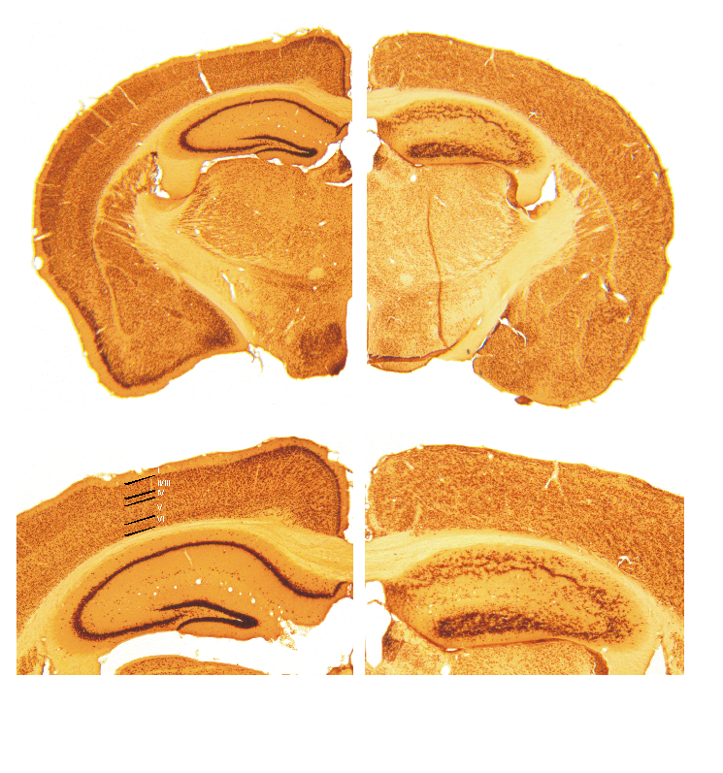
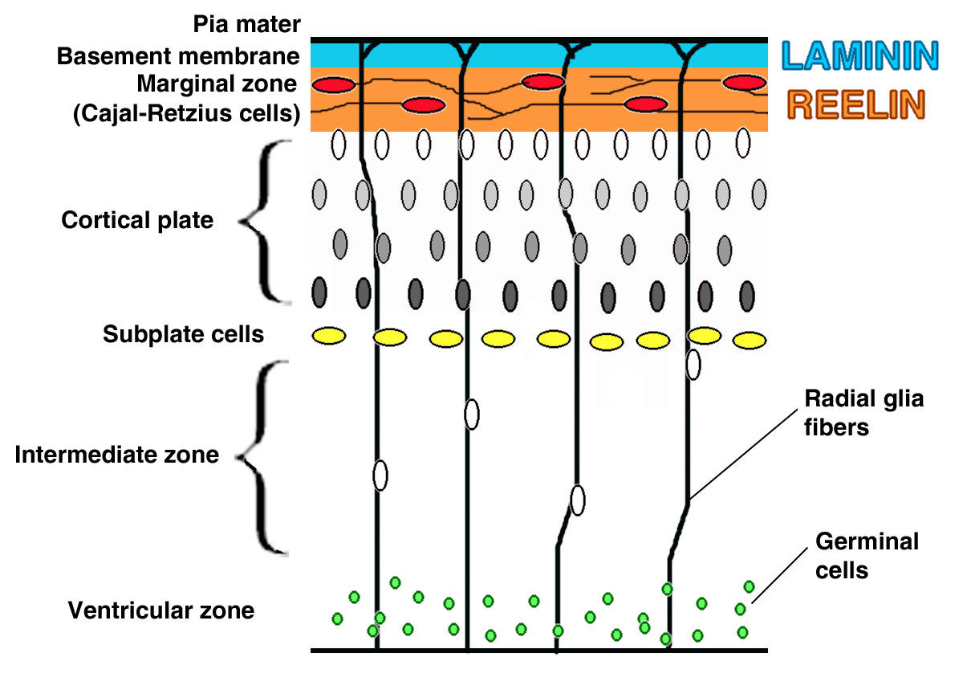
Knockout: Reeler Mice

Slide 36
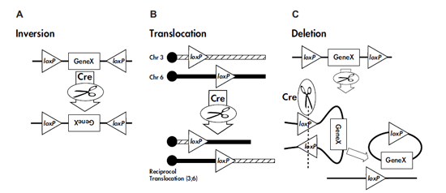
Cre-loxp Recombination

Slide 37
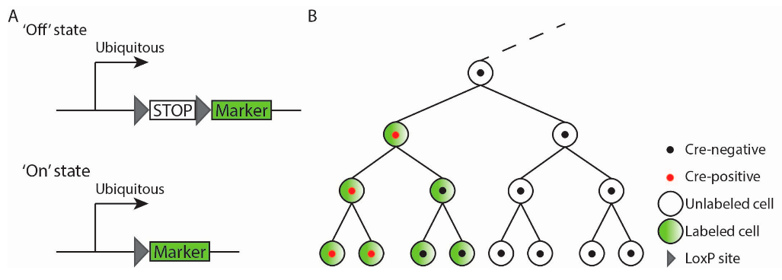
Lineage Tracing Using Transgenic Approaches

Slide 38
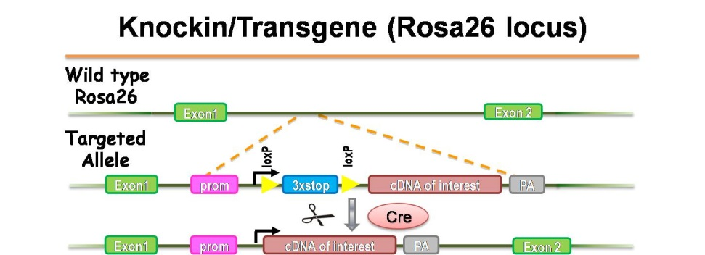
Rosa26

Slide 39
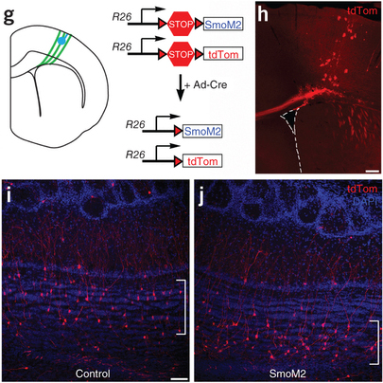

Slide 40
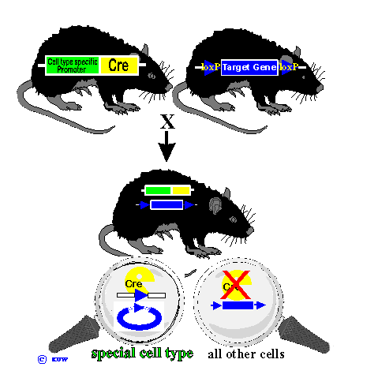
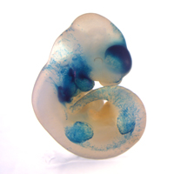
Cre-LoxP Knockout

Slide 41
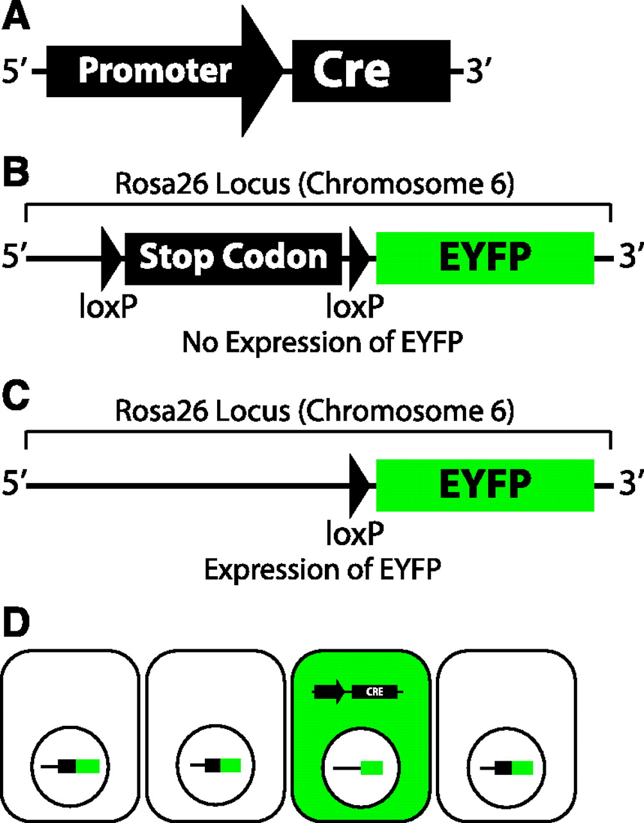
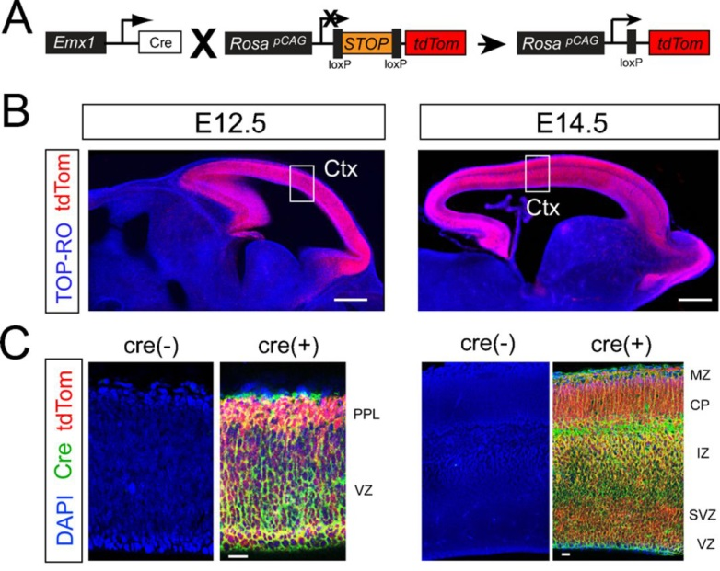
Cre-loxp Rosa26 Double Transgenic

Slide 42
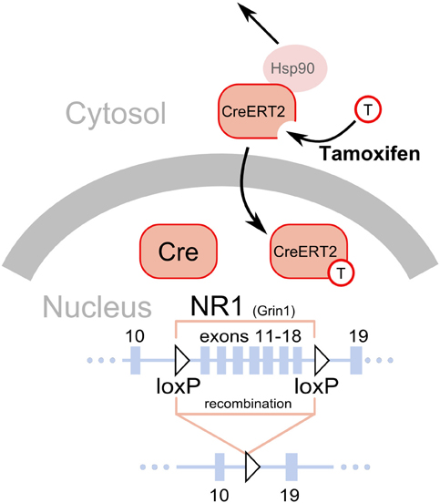
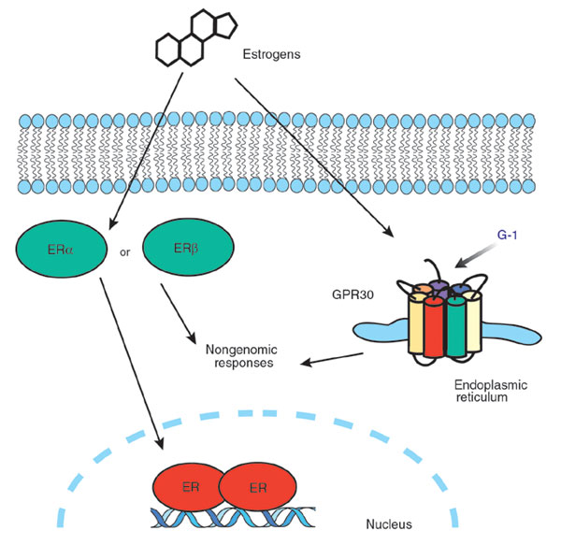
Cre-ER^{T2}

Slide 43
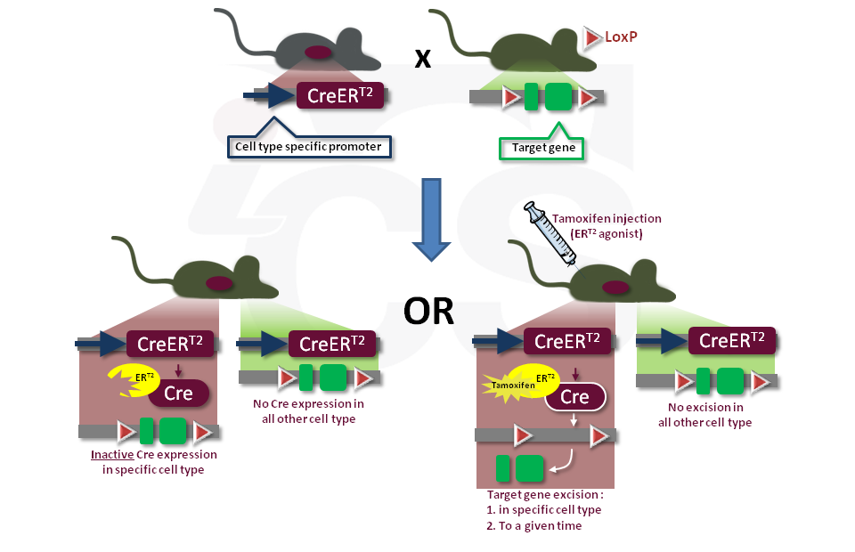
Double Transgene: Cre-ER^{T2}

Slide 44

Triple Transgenic

Slide 45

Really Funky Transgenic Approaches for Lineage Tracing

Slide 46

Crispr-Cas9 Technology

Slide 47


